Slide 1
Java Network/Socket Programming

Slide 2
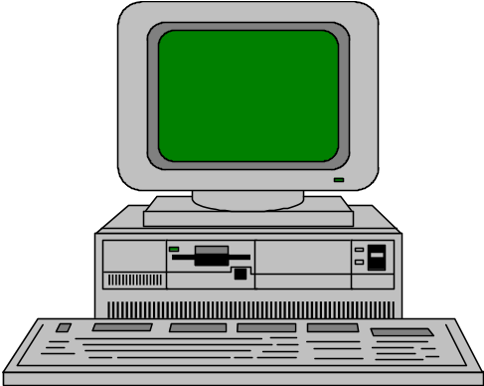


Elements of C-S Computing
a client, a server, and network
Request
Client
Server
Network
Result
Client machine
Server machine

Slide 3
java.net
Used to manage:
  URL streams
  Client/server sockets
  Datagrams

Slide 4
Part III - Networking
ServerSocket(1234)
Output/write stream
Input/read stream
Socket(“128.250.25.158”, 1234)
Server_name: “manjira.cs.mu.oz.au”

Slide 5
Server side Socket Operations
1. Open Server Socket:
ServerSocket server;
DataOutputStream os;
DataInputStream is;
server = new ServerSocket( PORT );
2. Wait for Client Request:
Socket client = server.accept();
3. Create I/O streams for communicating to clients
is = new DataInputStream( client.getInputStream() );
os = new DataOutputStream( client.getOutputStream() );
4. Perform communication with client
Receiive from client: String line = is.readLine();
Send to client: os.writeBytes("Hello\n");
5. Close sockets: client.close();
For multithreade server:
while(true) {
i. wait for client requests (step 2 above)
ii. create a thread with “client” socket as parameter (the thread creates streams (as in step (3) and does communication as stated in (4). Remove thread once service is provided.
}

Slide 6
Client side Socket Operations
1. Get connection to server:
client = new Socket( server, port_id );
2. Create I/O streams for communicating to clients
is = new DataInputStream( client.getInputStream() );
os = new DataOutputStream( client.getOutputStream() );
3. Perform communication with client
Receiive from client: String line = is.readLine();
Send to client: os.writeBytes("Hello\n");
4. Close sockets: client.close();

Slide 7
A simple server (simplified code)
import java.net.*;
import java.io.*;
public class ASimpleServer {
public static void main(String args[]) {
// Register service on port 1234
ServerSocket s = new ServerSocket(1234);
Socket s1=s.accept(); // Wait and accept a connection
// Get a communication stream associated with the socket
OutputStream s1out = s1.getOutputStream();
DataOutputStream dos = new DataOutputStream (s1out);
// Send a string!
dos.writeUTF(“Hi there”);
// Close the connection, but not the server socket
dos.close();
s1out.close();
s1.close();
}
}

Slide 8
A simple client (simplified code)
import java.net.*;
import java.io.*;
public class SimpleClient {
public static void main(String args[]) throws IOException {
// Open your connection to a server, at port 1234
Socket s1 = new Socket("130.63.122.1",1234);
// Get an input file handle from the socket and read the input
InputStream s1In = s1.getInputStream();
DataInputStream dis = new DataInputStream(s1In);
String st = new String (dis.readUTF());
System.out.println(st);
// When done, just close the connection and exit
dis.close();
s1In.close();
s1.close();
}
}

Slide 9
Echo Server Client..
//client.java: client interface to server
import java.io.*;
import java.net.*;
public class client
{
int port_id;
String server; Socket slink;
DataOutputStream os;
DataInputStream is;
DataInputStream kbd;
public client( String args[] )
{
server = args[0];
port_id = Integer.valueOf(args[1]).intValue();
try
{
slink = new Socket( server, port_id );
os = new DataOutputStream( slink.getOutputStream() );
is = new DataInputStream( slink.getInputStream() );
kbd = new DataInputStream( System.in );
}

Slide 10
Echo Server Client..
catch( UnknownHostException e )
{
System.err.println( "Don't know about host: " );
System.exit(1);
}
catch( IOException e )
{
System.err.println( "Could not get I/O for the connection to "+server);
System.exit(1);
}
}
void communicate()
{
while(true)
{
try {
System.out.print("Enter Input <end to stop>: ");
String line = kbd.readLine();
os.writeBytes( line+"\n" );

Slide 11
Echo Server Client..
if( line.equals("end") )
{ os.close(); is.close(); slink.close();
break;
}
String line2 = is.readLine();
System.out.println("Output: "+line2);
}
catch( IOException e )
{ System.out.println(e); }
}
}
public static void main( String [] args )
{
if( args.length < 2 )
{
System.out.println("Usage: java client server_name port_id" );
System.exit(1);
}
client cln = new client( args );
cln.communicate();
}
}

Slide 12
Echo Server ...
// server.java: echo server
import java.io.*;
import java.net.*;
public class server
{
// public final static int PORT = 4779;
public static void main( String [] args )
{
ServerSocket server = null;
DataOutputStream os = null;
DataInputStream is = null;
boolean shutdown = false;
if( args.length < 1 )
{
System.out.println( "Usage: java server port_num" );
System.exit( 1 );
}
int PORT = Integer.valueOf(args[0]).intValue();
try {
server = new ServerSocket( PORT );
}

Slide 13
Echo Server ...
catch( IOException e )
{
System.err.println( "Could not get I/O for the connection to: ");
}
while(!shutdown)
{
if( server != null )
{
try
{
Socket client = server.accept();
System.out.println("Connected");
InetAddress cip = client.getInetAddress();
System.out.println( "Client IP Addr: "+cip.toString());
is = new DataInputStream( client.getInputStream() );
os = new DataOutputStream( client.getOutputStream() );
for(;;)
{
String line = is.readLine();
if( line == null )
break;

Slide 14
Echo Server ...
if( line.startsWith("end" ) )
{
shutdown = true;
break;
}
os.writeBytes(line.toUpperCase());
os.writeBytes("\n");
System.out.println(line);
}
is.close(); client.close();
}
catch( UnknownHostException e )
{
System.err.println( "Server Open fails" );
}
catch( IOException e )
{
System.err.println( "Could not get I/O for the connection to:"+args[0]);
}
} }

Slide 15
Echo Server
System.out.println( "Server Down" );
try {
server.close();
} catch(IOException e) {}
}
}

Slide 16
Threads in Action...
Multithreaded Server
Server Process
Client Process
Server
Threads
Client Process
User Mode
Kernel Mode
Message Passing
Facility

Slide 17
Client/Server Computing

Slide 18
Client Server Definition
“ server software accepts requests for data from client software and returns the results to the client”

Slide 19
Elements of C-S Computing
a client, a server, and network
Request
Client
Server
Network
Result
Client machine
Server machine

Slide 20
Where Operations are Done
In CS Relationship “most of the application processing is done on a computer (client side), which obtains application services (such as database services) from another computer (server side) in a master slave configuration.

Slide 21
CS-Focus is on
In client-server computing major focus is on SOFTWARE

Slide 22



Application Tasks
User Interface
Presentation Logic
Application Logic
Data Requests & Results
Physical Data Management

Slide 23
Client (dumb) - Server Model
Server
Client
Keystroke
Presentation Logic
Network
Application Logic
Displays
DBMS

Slide 24
True Client-Server Model
Server
Client
Keystroke
Presentation Logic
Application Logic
Network
DBMS
Processed
Results

Slide 25
Distributed Client-Server Model
Server
Client
Processed
Queries
Application Logic
Application Logic
Network
DBMS
Presentation Logic
Processed
Results

Slide 26
Client-server computing is distributed access, not a distributed computing.

Slide 27

RPC Look and Feel like Local Calls
results=
bar(arguments)
calling
procedure
results=
bar(arguments)
called
procedure
calling
procedure
(client)
results=
bar(arguments)
arguments
results
results
arguments
client stub
network transport
server stub
network transport
arguments
results
called
procedure
(client)
request message
reply message
reply message
request message
Network
Local Procedure Call
Remote Procedure Call

Slide 28

Flow Control in a Sychronous RPC
Client Machine
Server Machine
Service Daemon Listening
Client
Program
RPC Call
Invoke Service
with Request
Service Call
Client
Waiting
Network
Service Executes
return() answer
return ( )
Request Completed
reply
May be the same machine

Slide 29
Multithreaded Server
Server Process
Client Process
Server
Threads
Client Process
User Mode
Kernel Mode
Message Passing
Facility

Slide 30
Categories of Servers
File Server
Data Server
Compute Server
Database Server
Communication Server
Video Server

Slide 31
File Server
File Servers manage a work group’s application and data files, so that they may be shared by the group.
Very I/O oriented
Pull large amount of data off the storage subsystem and pass the data over the network
Requires many slots for network connections and a large-capacity, fast hard disk subsystem.

Slide 32
Compute Server
Performs Application logic processing
Compute Servers requires
  processors with high performance capabilities
  large amounts of memory
  relatively low disk subsystems
By separating data from the computation processing, the compute server’s processing capabilities can be optimized

Slide 33
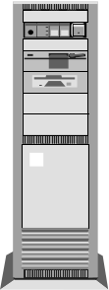
Data Server
Data-oriented; used only for data storage and management
Since a data server can serve more than one compute server, compute-intensive applications can be spread among multiple severs
Does not prefer any application logic processing
Performs processes such as data validation, required as part of the data management function.
Requires fast processor, large amount of memory and substantial Hard disk capacity.
Data
Server
Compute
Server

Slide 34
Database Server
Most typical use of technology in client-server
Accepts requests for data, retrieves the data from its database(or requests data from another node)and passes the results back.
Compute server with data server provides the same functionality.
The server requirement depends on the size of database, speed with which the database must be updated, number of users and type of network used.

Slide 35
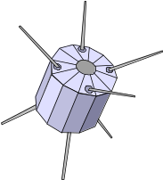


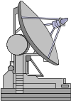
Communication Server
Provides gateway to other LANs, networks & Computers
E-mail Server & internet server
Modest system requirements
  multiple slots
  fast processor to translate networking protocols

Slide 36
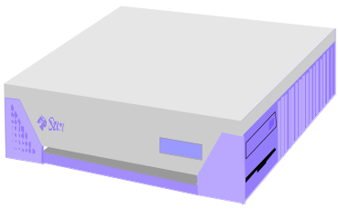
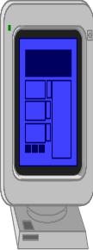

Internet Server
PC client
Internet Server
Local Area
Network
UNIX workstations

Slide 37
Distributed processing application connects to remote database
S Q L *
Forms
SQL *Net
TCP/IP
UNIX Server
Distributed database application connects to local database which connects to remote database
SQL *Net
TCP/IP
SQL *
Forms
ORACLE
SQL *Net
TCP/IP
ORACLE
Database Configurations

Slide 38
Client-Server Waves
Ethernet era
client/server
Intergalactic era
client/server
First Wave
Second Wave
Third Wave
Database
servers
File
servers
Distributed
objects
groupware
TP
monitors
1982
1986
1990
1994
1998

Slide 39
The Client/Server Infrastructure
Client
Middleware
Server
Service Specific
SQL/IDAPI
TxRPC
Mail
ORB
Objects
GUI/OOUI
DSM
Groupware
SNMP
CMIP
DME
TP
monitor
NOS
Directory
Security
Distributed file
RPC
Messaging
Peer-to-peer
DBMS
DSM
Transport Stack
DSM
Operating System
NetBIOS
TCP/IP
IPX/SPX
SNA
Operating System

